Slide 1
Public Distribution Tracking System
Simplified & Efficient PDS with IoT

Slide 2
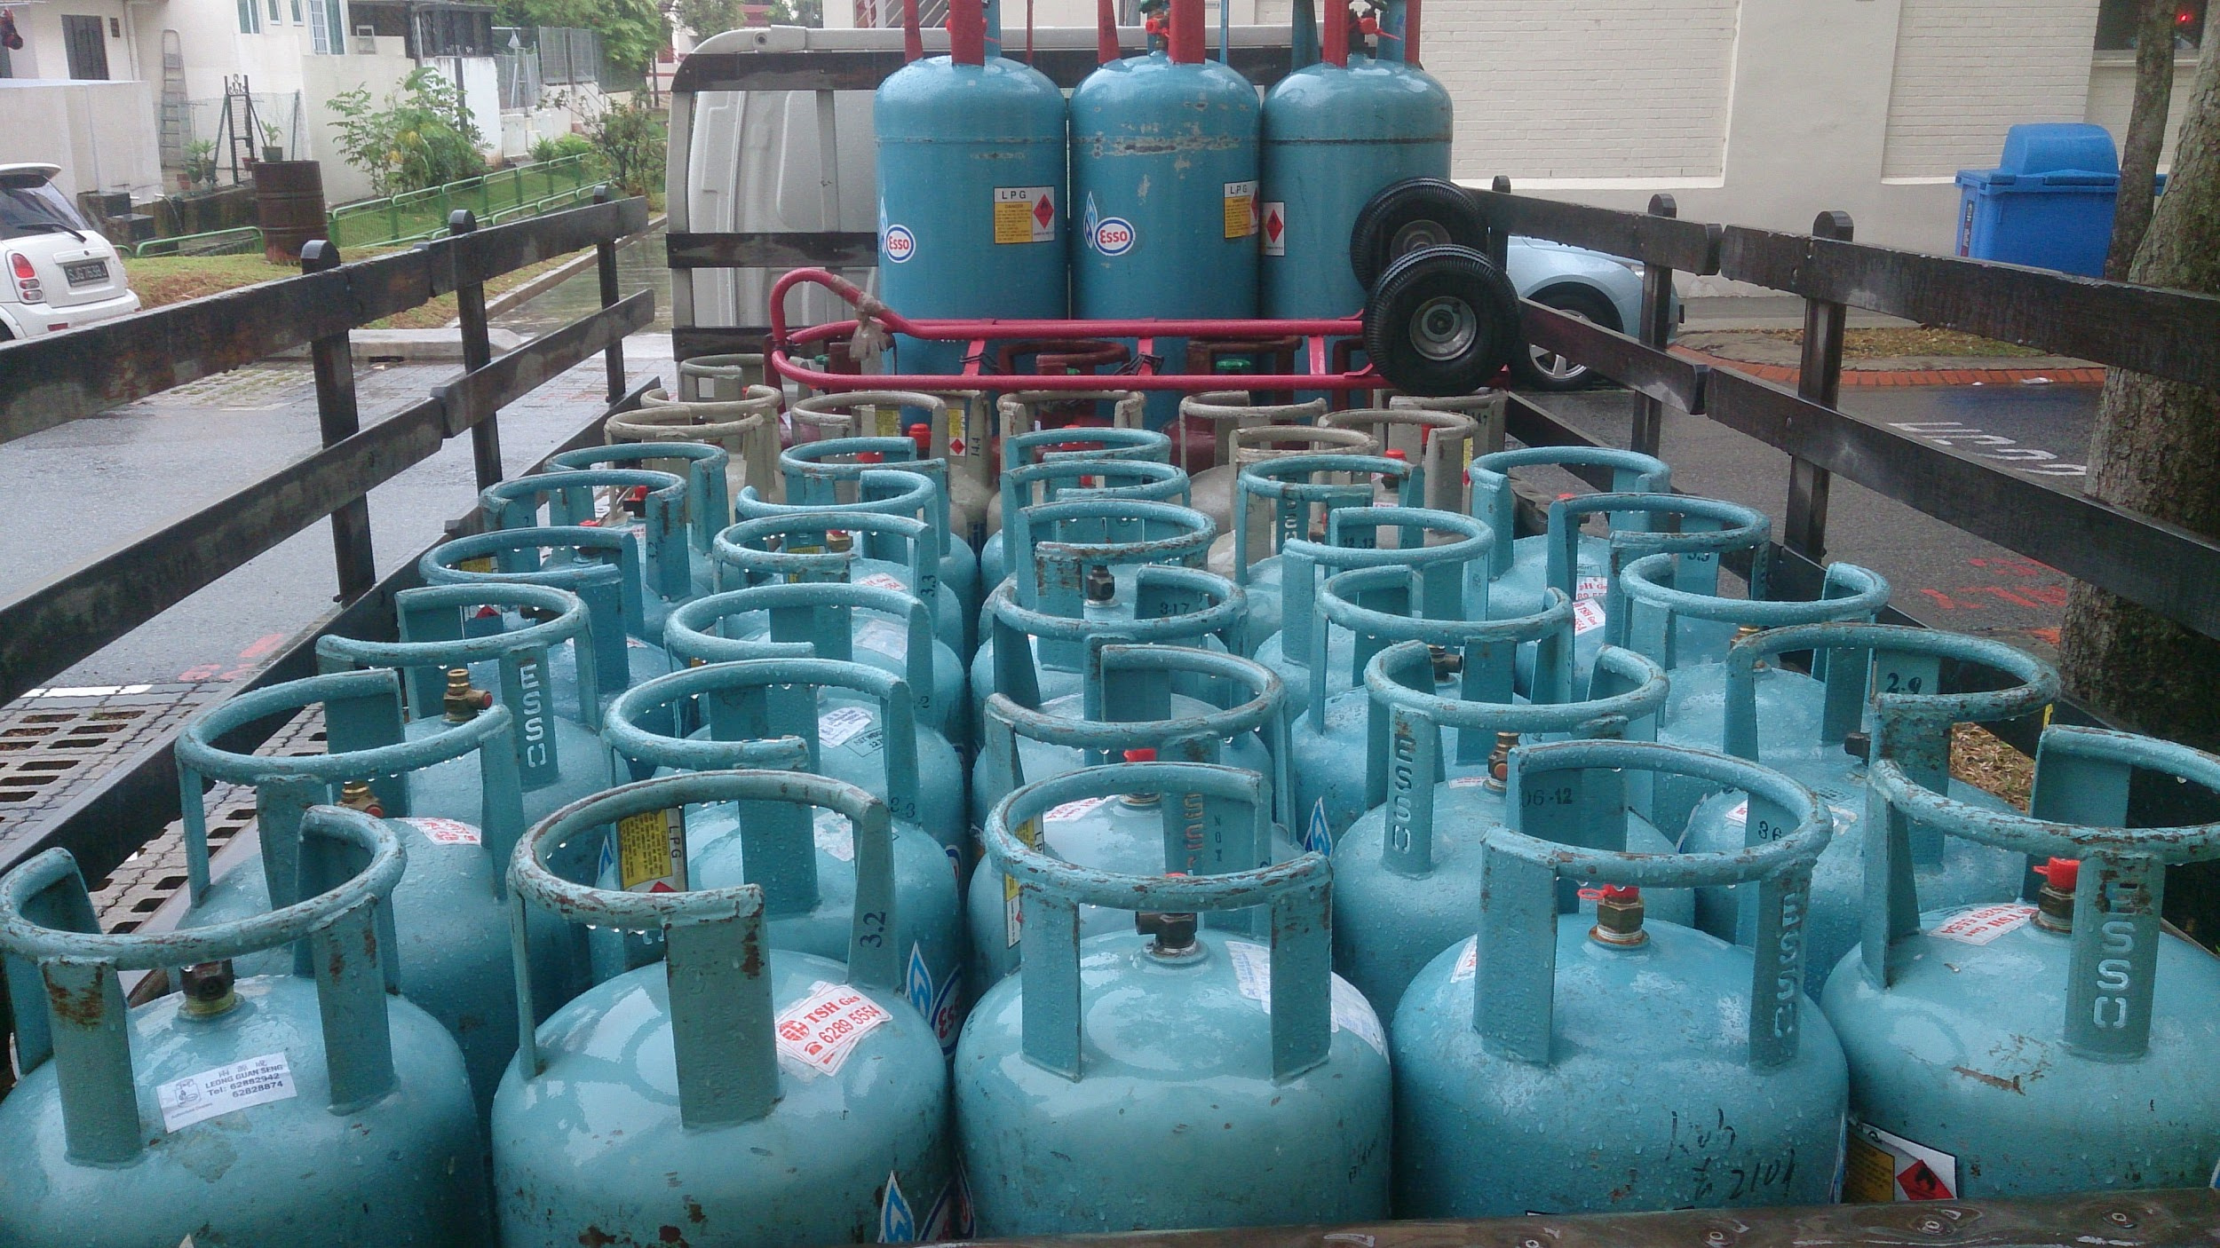
INDUSTRY 4.0
Transparent & Efficient PDS with minimal efforts

Slide 3
The problem
State-owned fuel retailers are losing Rs 393.50 per 14.2-kg domestic cooking gas LPG through the Public Distribution system (PDS).
20XX | 20XX | 20XX | 20XX

Slide 4

The solution
QR-Code/RFID can be placed on individual cylinders to make sure it reaches it’s proper destination.
Simple and effective technique for preventing the misplacement of cylinders.

Slide 5
How it works
Step 3
Step 2
Step 1
When cylinder is delivered, the customer will scan the QR thus Cloud will be updated with user ID and location.
These QRs will be scanned at 3 stages(Factory outlet,local distributor, customer).
QR Codes will be placed on individual cylinders while dispatching from factory.

Slide 6

The technology:
RFID IBM Cloud

Slide 7
Revenue model
Manufacturer
Distributor
Consumer
The implementation cost for RFID tag per cylinder is around 100 which is incurred only at manufacturing time.
The total loss on PDS can be reduced by 1/4th of current stage.

Slide 8

The modified PDS can be implemented easily and is effective with the arrival of Industry 4.0

Slide 9
Thank You

